Slide 1
New video project Pizza sales DA
File created on: 7/5/2024 8:04:34 AM

Slide 2
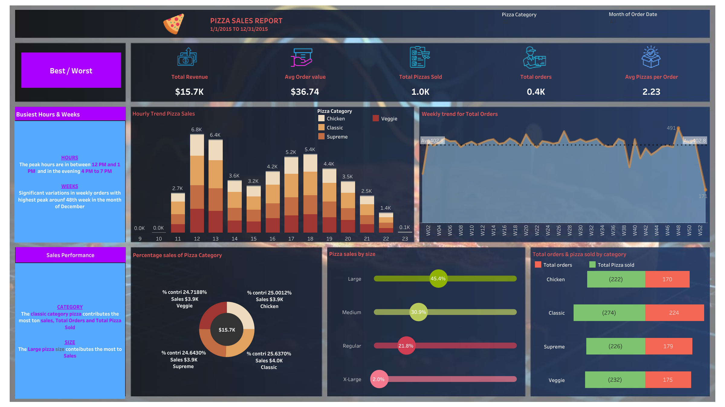

Slide 3
